Slide 1
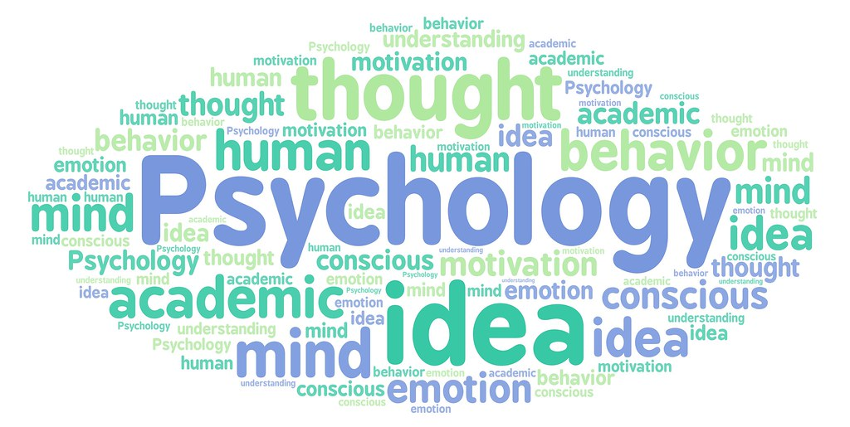
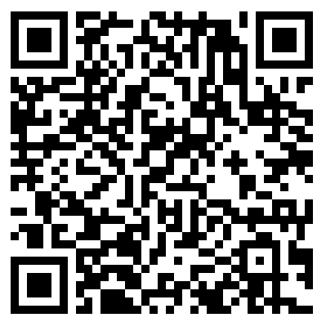
Introduction to Reproducible Science: Day 3
Nelson Roque, PhD
Scan for
Slides & Code available on GitHub
Notes:
Image: https://news.miami.edu/stories/2020/09/pandemic-popularizes-a-plethora-of-words,-phrases.html
https://www.flickr.com/photos/182229932@N07/48189906827

Slide 2
Agenda: Day 3
Text mining
Skill 1: word and bigram frequency analysis
Skill 2: generating wordclouds
Skill 3: sentiment analysis
Interacting with APIs and JSON data
Skill 4: querying API for results and data aggregation
Closing Discussion & Q/A

Slide 3

What is NLP?
Methods from various disciplines to enable computers to understand human language in both written and verbal forms:
computer science,
artificial intelligence,
linguistics,
data science
Notes:
Image: https://en.wikipedia.org/wiki/Siri
https://www.ibm.com/cloud/learn/natural-language-processing
https://www.ibm.com/blogs/watson/2020/11/nlp-vs-nlu-vs-nlg-the-differences-between-three-natural-language-processing-concepts/

Slide 4
What is NLP?
Examples of NLP tasks to make sense of text/voice data include
Speech Recognition
Speech to text
Part of speech tagging
identifies ‘make’ as a verb in ‘I can make a paper plane,’
and as a noun in ‘What make of car do you own?’
Word sense disambiguation
E.g., distinguish the meaning of the verb 'make' in ‘make the grade’ (achieve) vs. ‘make a bet’ (place)
Named entity recognition
E.g., Identifying Florida as a location
Co-reference resolution
identifying if and when two words refer to the same entity
Sentiment Analysis
extract subjective qualities — attitudes, emotions, sarcasm, confusion, suspicion
Natural language generation
Creating human language based on structured information
Notes:
https://www.ibm.com/cloud/learn/natural-language-processing
https://www.ibm.com/blogs/watson/2020/11/nlp-vs-nlu-vs-nlg-the-differences-between-three-natural-language-processing-concepts/

Slide 5

What is Text Mining?
Analyzing text data for key topics, trends, and hidden relationships
Word frequency analysis
Wordclouds
Topic modeling
Especially important since, 80% of the world’s data is in an unstructured format
Consider the data processing implications of your data source
Correcting misspellings
Correcting incorrect transcriptions (from audio/video)
https://www.tidytextmining.com
Notes:
Speech recognition, also called speech-to-text, is the task of reliably converting voice data into text data. Speech recognition is required for any application that follows voice commands or answers spoken questions. What makes speech recognition especially challenging is the way people talk—quickly, slurring words together, with varying emphasis and intonation, in different accents, and often using incorrect grammar.
Part of speech tagging, also called grammatical tagging, is the process of determining the part of speech of a particular word or piece of text based on its use and context. Part of speech identifies ‘make’ as a verb in ‘I can make a paper plane,’ and as a noun in ‘What make of car do you own?’
Word sense disambiguation is the selection of the meaning of a word with multiple meanings through a process of semantic analysis that determine the word that makes the most sense in the given context. For example, word sense disambiguation helps distinguish the meaning of the verb 'make' in ‘make the grade’ (achieve) vs. ‘make a bet’ (place).
Named entity recognition, or NEM, identifies words or phrases as useful entities. NEM identifies ‘Kentucky’ as a location or ‘Fred’ as a man's name.
Co-reference resolution is the task of identifying if and when two words refer to the same entity. The most common example is determining the person or object to which a certain pronoun refers (e.g., ‘she’ = ‘Mary’), but it can also involve identifying a metaphor or an idiom in the text (e.g., an instance in which 'bear' isn't an animal but a large hairy person).
Sentiment analysis attempts to extract subjective qualities—attitudes, emotions, sarcasm, confusion, suspicion—from text.
Natural language generatio

Slide 6
Terminology
Bigrams
Pairs of words
Ngrams
A set of words with length of N
Bag of words
Count frequency of words in document
tf-idf (term frequency - inverse document frequency)
Metric for determining how important a term is in a document
Determine
two documents are similar by comparing their TF-IDF vector using cosine similarity.
Keywords to summarize an article
Stemming
Extract root words (like: like, liking, likely)
Stop words
Words like ‘a’, ‘the’ – frequent but not always useful for NLP tasks
Lexicons: onix, SMART, snowball
Notes:
tf-idf - https://www.capitalone.com/tech/machine-learning/understanding-tf-idf/
Stop word lexicons: onix, SMART, snowball. Full listing of words [available here](https://www.kaggle.com/code/therohk/stopwords-compared-snowball-smart-onix/report).
- [Learn more about `onix`](http://www.lextek.com/manuals/onix/stopwords1.html)
- [Learn more about `SMART`](https://www.jmlr.org/papers/volume5/lewis04a/lewis04a.pdf)
- [Learn more about `snowball`](http://snowball.tartarus.org/algorithms/english/stop.txt)

Slide 7
Sentiment Analysis: Lexicons
bing
“positive”/“negative” classification
AFINN
score between -5 (most negative) and 5 (most positive)
loughran
“positive”/“negative”/“litigious”/“uncertainty”/“constraining”/“superflous” classification
nrc
binary “yes”/“no” for categories positive, negative, anger, anticipation, disgust, fear, joy, sadness, surprise, and trust

Slide 8

Topic modeling

Slide 9
Topic modeling
One of the most common algorithms, Latent Dirichlet allocation (LDA), for topic modeling guided by two principles:
Every document is a mixture of topics.
We imagine that each document may contain words from several topics in particular proportions.
For example, in a two-topic model we could say “Document 1 is 90% topic A and 10% topic B, while Document 2 is 30% topic A and 70% topic B.”
Every topic is a mixture of words.
For example, we could imagine a two-topic model of American news, with one topic for “politics” and one for “entertainment.”
The most common words in the politics topic might be “President”, “Congress”, and “government”, while the entertainment topic may be made up of words such as “movies”, “television”, and “actor”.
Importantly, words can be shared between topics; a word like “budget” might appear in both equally.
LDA is a mathematical method for estimating both of these at the same time: finding the mixture of words that is associated with each topic, while also determining the mixture of topics that describes each document.
https://www.tidytextmining.com/topicmodeling.html
Notes:
https://sicss.io/2019/materials/day3-text-analysis/topic-modeling/rmarkdown/Topic_Modeling.html

Slide 10
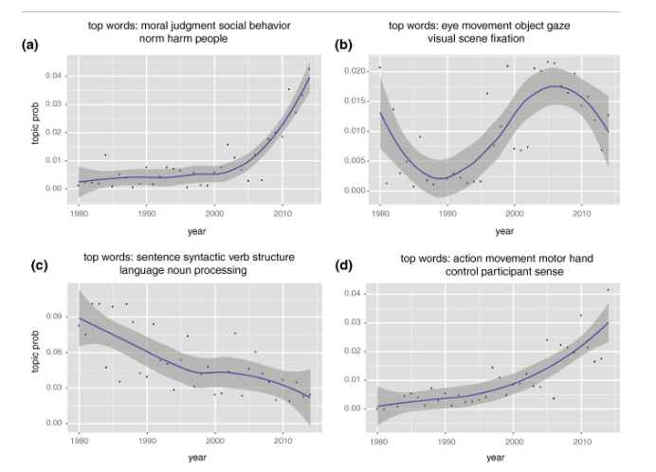

Slide 11
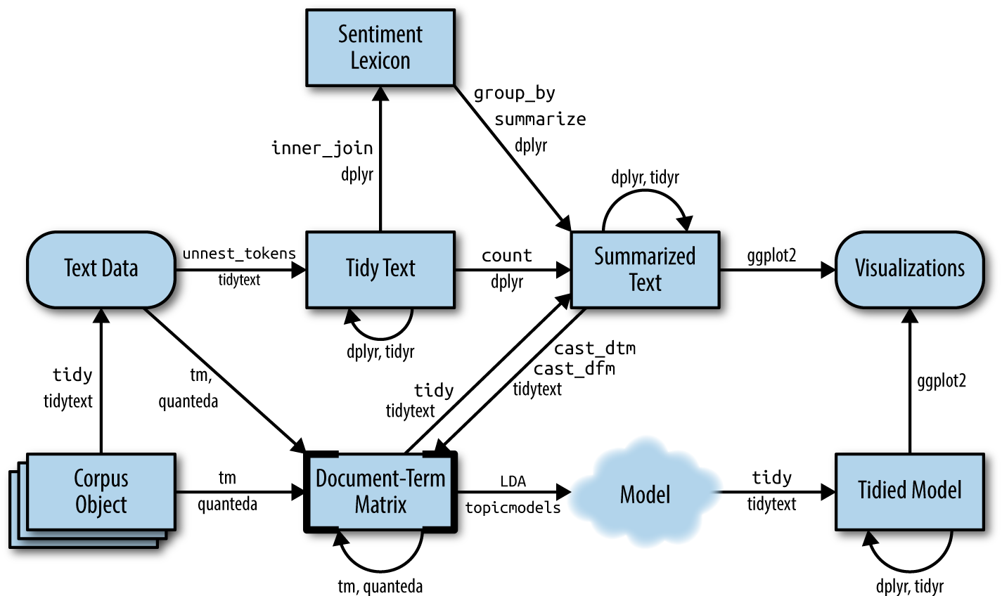
Notes:
https://www.tidytextmining.com/topicmodeling.html
Figure 6.1: A flowchart of a text analysis that incorporates topic modeling. The topicmodels package takes a Document-Term Matrix as input and produces a model that can be tided by tidytext, such that it can be manipulated and visualized with dplyr and ggplot2.

Slide 12
Skill 1: Word and bigram frequency analysis

Slide 13
Skill 2: Generating wordclouds

Slide 14
Skill 3: Sentiment analysis

Slide 15
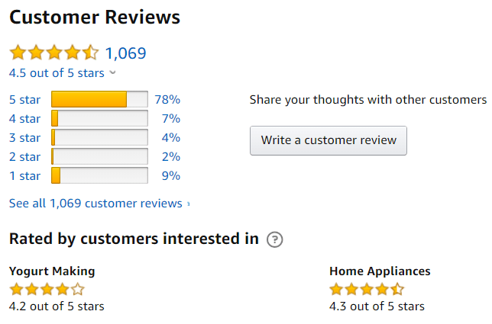
The Data
For this example, we will work with real and fake product review data from the following open science resource: https://osf.io/tyue9
Salminen, J., Kandpal, C., Kamel, A. M., Jung, S., & Jansen, B. J. (2022). Creating and detecting fake reviews of online products. Journal of Retailing and Consumer Services, 64,102771. https://doi.org/10.1016/j.jretconser.2021.102771

Slide 16
Let’s jump into R
Scan the QR code to view the code we will work with
Notes:
2-r-basics.Rmd

Slide 17
Skill 4: Working with APIs

Slide 18
What is an API?
Application Programming Interface
Method to communicate with the data layer of an application to accomplish business / research function, e.g.,
Store and query data
Update settings
Login/logout
Retrieve resources (e.g., images)
APIs make the modern world go round
From airlines, to your groceries, to functionality in almost every mobile app, APIs are charged with securely and efficiently shipping data back and forth between entities and their consumers.

Slide 19
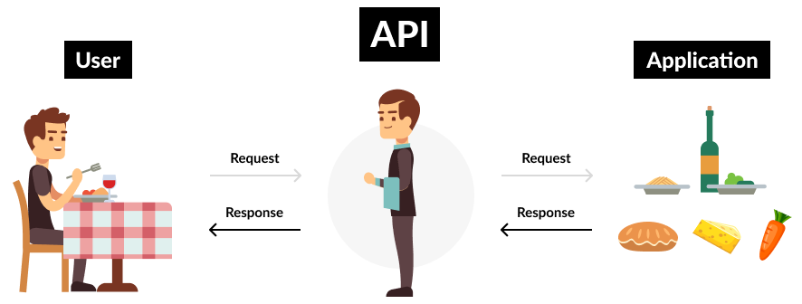
What is an API?
https://www.mindtree.com/insights/blog/rise-apis-financial-services-key-future
Notes:
Image: https://www.mindtree.com/insights/blog/rise-apis-financial-services-key-future

Slide 20
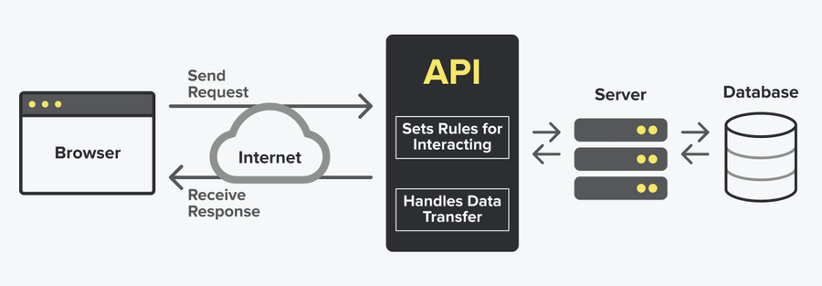
What is an API?
https://snipcart.com/blog/integrating-apis-introduction
Notes:
Image: https://snipcart.com/blog/integrating-apis-introduction

Slide 21

Jeff Bezos’ API Mandate at Amazon
All teams will henceforth expose their data and functionality through service interfaces.
Teams must communicate with each other through these interfaces.
There will be no other form of interprocess communication allowed: no direct linking, no direct reads of another team’s data store, no shared-memory model, no back-doors whatsoever. The only communication allowed is via service interface calls over the network.
It doesn’t matter what technology they use.
All service interfaces, without exception, must be designed from the ground up to be externalizable. That is to say, the team must plan and design to be able to expose the interface to developers in the outside world. No exceptions.
Anyone who doesn’t do this will be fired.
Thank you; have a nice day!
https://nordicapis.com/the-bezos-api-mandate-amazons-manifesto-for-externalization

Slide 22
Special Considerations
Authentication
Rate-limiting
Query by Offsets, and limits

Slide 23
Let’s jump into R
Scan the QR code to view the code we will work with
Notes:
2-r-basics.Rmd

Slide 24
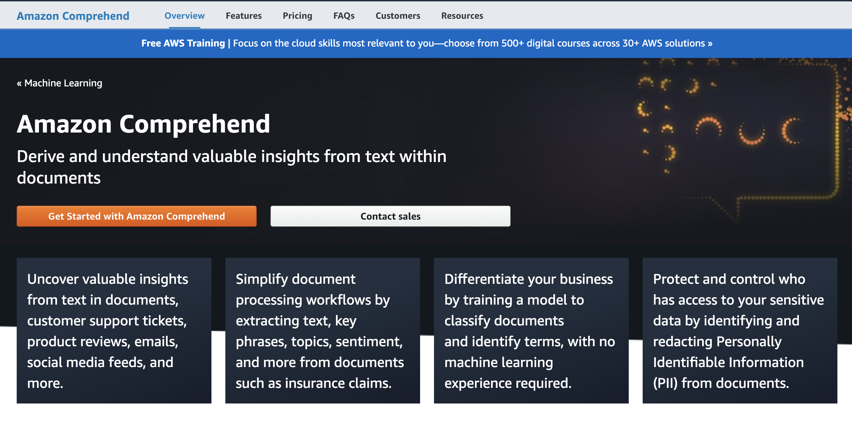
NLP as a Service (NLPaaS)

Slide 25
Thank you!
Closing Discussion
Q&A
What other topics could be helpful in supporting your research?
Working with image data?
Video data?
Geographic data + geocoding?
Emotion detection?
Machine learning?

Slide 26

You are not alone

Slide 27





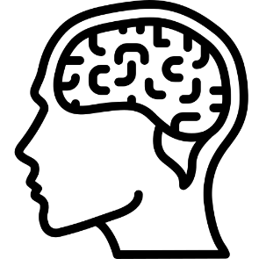



nelson.roque@ucf.edu
nelsonroque.com
https://github.com/nelsonroque
thank
you

